Slide 1
Proposed 2018 Narrative Budget
Annual Congregational Meeting
January 28, 2018

Slide 2
Historical Budget Overview

Slide 3
2017 Financial Review

Slide 4
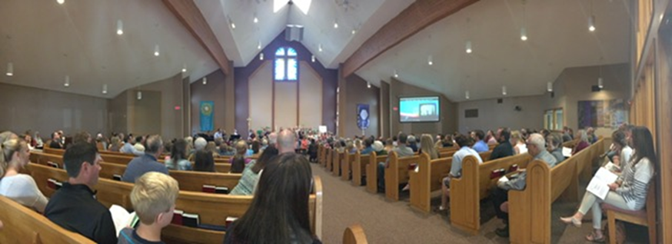
Narrative Budget
Shows our resource use by mission category
Ensure our priorities are in line with LOC mission
Summary of faith giving, volunteer hours (12,217)
Detailed line item budgets in annual report

Slide 5
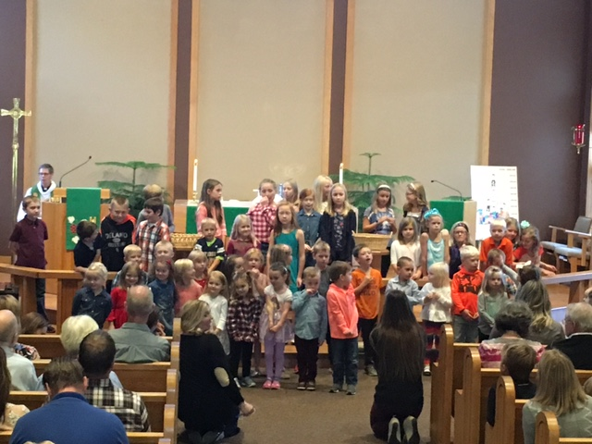
Worship
At Light of Christ, our Worship Ministry is the center of who we are in Christ. Our worship consists of time dedicated by our Pastor, Music Director and CYF Director along with all of our committee members and volunteers coordinating our weekly Worship services, weddings, funerals, and baptisms. Our volunteers enhance our services through reading scripture, greeting people, ushering and providing special music and helping with communion preparation. Our worship fills us each week so we can be the Light of Christ for others in our world.
Worship the Lord with gladness, come before him with joyful songs.
Psalm 100:2
Estimated Volunteer Hours
2,907

Slide 6
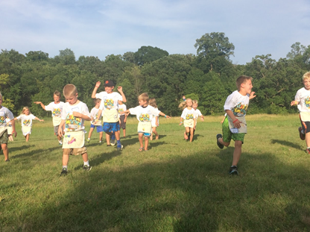
Education
In learning about the Bible and connecting God’s word to our lives, each of us grows in our knowledge and love of God and in our relationship with Christ and each other. Here at Light of Christ we offer faith education for children, youth, and adults to provide a path for each person to move along his or her own faith journey and to equip all of us to live as God’s people in our world today.
Some of our education ministries include:
Sunday school for children and adults
Small group ministry
Library
Vacation Bible school
Confirmation
Junior High and High School events
Youth mission trips
Milestone ministries including baptism, children receiving age appropriate Bibles, first communion, confirmation, and many more.
Estimated Volunteer Hours
5,010

Slide 7
Community
Light of Christ embodies a congregation who desires to witness and share the joy we find in Jesus Christ. Community Life is inviting others to experience this joy by creating an environment where everyone feels a sense of belonging and being cared for by God and this congregation. Everyone is welcome and encouraged to participate.
Organize and carry out projects aimed at helping those less fortunate in our community and globally. A few examples are year-round collection of food & personal care items for:
Love, INC (LOC is a partner church giving 1% of Faith Sharing)
Helping Hands Food Shelf
School Supplies drive
Christmas Sharing
Birthday Ministry
Buck-A-Chick
Chile Missionary Karen Anderson
Estimated Volunteer Hours
1,944

Slide 8
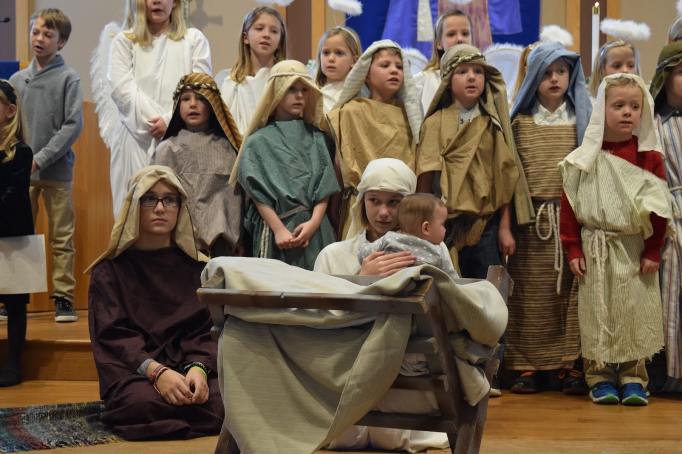
Caring
Caring covers a variety of ministry activities that can take place within the church walls, or at hospitals, at nursing homes, or even in jails - wherever people need a guiding light. At the heart of this ministry, is spending time with the congregation at Light of Christ and with others throughout our community when needed. It can range from practical friendly advice, comforting an individual or group, to crisis management. It is about bringing Jesus Christ into people’s lives at their time of need. This is a ministry without boundaries to be performed by all of God's "faithful stewards".
Each of you should use whatever gift you have received to serve others, as faithful stewards of God’s grace in its various forms.
1 Peter 4:10
Estimated Volunteer Hours
1,200

Slide 9
Benevolence
Benevolence is the tithing that Light of Christ gives to the ELCA. Ten percent of our giving goes to support the Minneapolis Area Synod and the ELCA church wide ministries, each getting one half of that 10%. Note: 6% total is the national average for ELCA congregations. A sampling is listed below:
Congregation work includes helping congregations undergoing renewal, formation of new congregations, and congregations serving various community needs such as transient, artistic, fitness, inner city.
Synods support the work of missionaries, leadership and internship programs, seminary programs, and social justice and civic engagement.
Churchwide work includes chaplain ministry, advocacy work, young adult global mission programs, multicultural ministry and leadership events.
Estimated Volunteer Hours
1,200

Slide 10
Budget and Spending History

Slide 11
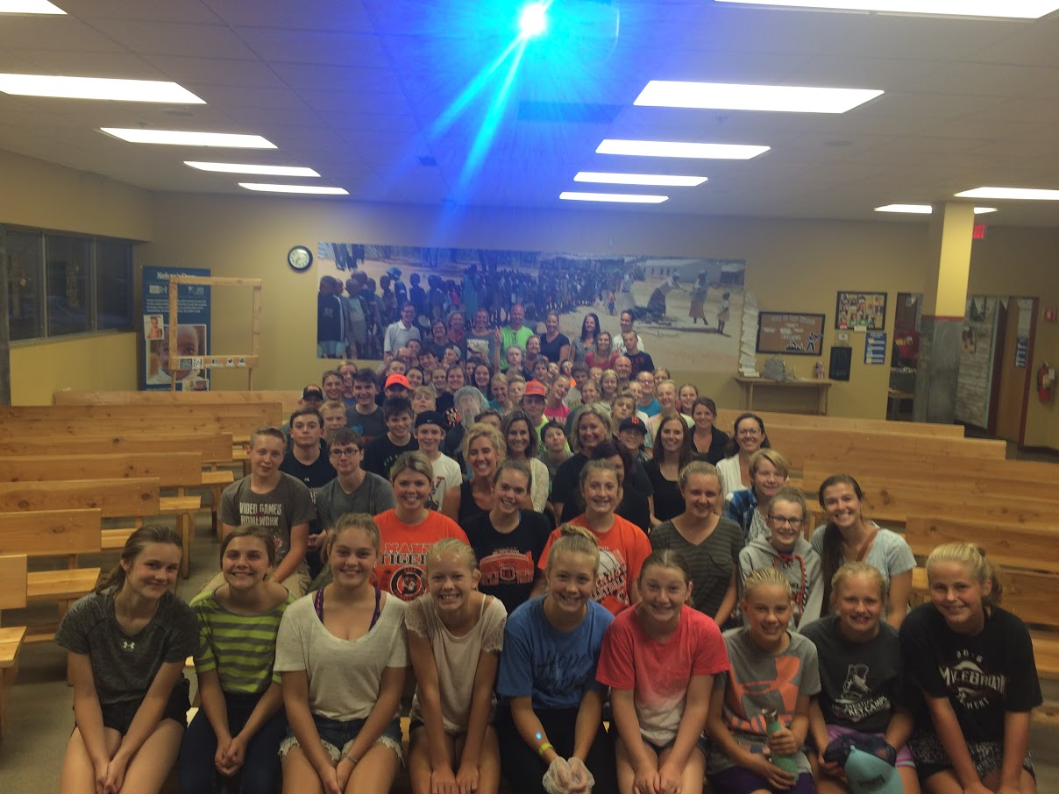
2018 Budget Decision Points
2017 Surplus was $18,517
$10,000 will be used for Web site upgrade
$3,000 to replace front sidewalk
2018 notes
Increase in staff compensation (first in 2 1/2 years)
Youth Assistant position (10 hours per week)
Music budget increase
Increase in Synod/ELCA Support (Benevolence)
Building maintenance increase
$1,000 cross refurbish
$3,000 Window replacement
$2,100 HVAC repair

